Slide 1

EXPENSE TRACKING [INDUSTRIAL TRAINING PROJECT] Date- 05/12/2022 Programme- B.TECH [CSE]
SUBMITTED TO SUBMITTED BY
Aashish Bishnoi NEHA VERMA
(TCA1909064)
FACULTY OF ENGINEERING
TEERTHANKER MAHAVEER UNIVERSITY, MORADABAD

Slide 2
1- INTRODUCTION
Python is known for its general-purpose nature that makes it applicable in almost each domain of the software development. Python as a whole can be used in any sphere of development.
The purpose of this project is to develop a user-friendly GUI based Expense Tracking System. The application can be accessed and effectively used by the user.
Instead of doing manual work for making up a bill at Restaurant, which gets tiring and time consuming, you can generate a bill including tax and service charges in just few clicks. When making up a bill manually at a Restaurant may contain some human errors like adding wrong items into the bill or summing up their total also may end up wrong, it also sometimes results into a Bad Impression towards the Restaurant from a Customer. To overcome this problem, we have come up with this project, that is, Expense Tracking System Using Python.

Slide 3
IMPORTANCE
The Expense Tracking System using python is very useful to small business or restaurant or cafe or food truck owners. This helps the owner to fasten the process which is bug free and easy to use. It also has A calculator to ease the use of the user.
The project has been implemented in python. The system contains the menu which is available in the restaurant.
The owner or the cashier has to check the item ordered by the customer and enter the number of orders given for a particular item in the menu. Once the items are selected, the cashier can click on total to obtain the total for drinks and the food seperately. It displays the service charges and the tax also. When the cashier clicks on the receipt button, the receipt is generated.

Slide 4
SYSTEM REQUIRMENTS AND SPECIFICATIONS
Here we are including the software’s and hardware’s used for developing the project and for implementing the project
Software Requirements
Python 3,9
Vs code
3. Any OS
B. Hardware Requirements
1.4 GB RAM or above
2. Intel i3 Processor or above
3. 32 Bit System or above

Slide 5
SYSTEM IMPLEMENTATION
This project is developed using Python. While using this Expense Tracking System, you can easily calculate total bill of the customer. Moreover, the total bill is calculated including service charges and state tax. All you need to do is just fill up the blank boxes with item quantities and click on total button. The program will display your total bill. This system can be used in restaurants, cafe for calculating bills in a short period of time and it’s not time consuming.
It’s easy to operate and understand by users. There is no any error and warning contents in the project. The design is so simple that user won’t find it difficult to use and navigate.
To ease the use of the user we even have a calculator added to our system which performs all basic operations like Addition, Subtraction, Division and Multiplication. We’ll display Menu, Order no., Total and Reset. We assure that the project is bug free and easy to use. Since the program is for restaurant or providing services. It will add services charges and state taxes respectively. FLOW CHART

Slide 6
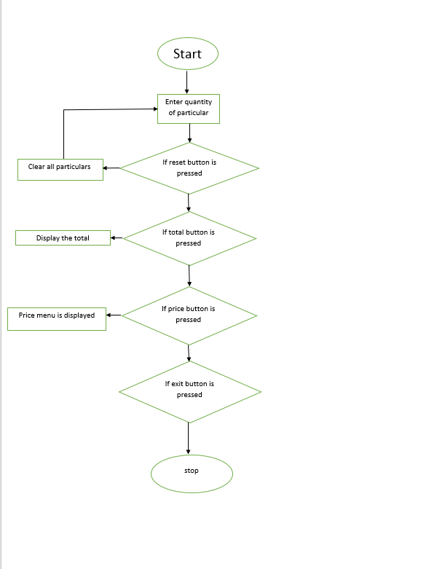
Harsh
FLOW CHART :

Slide 7
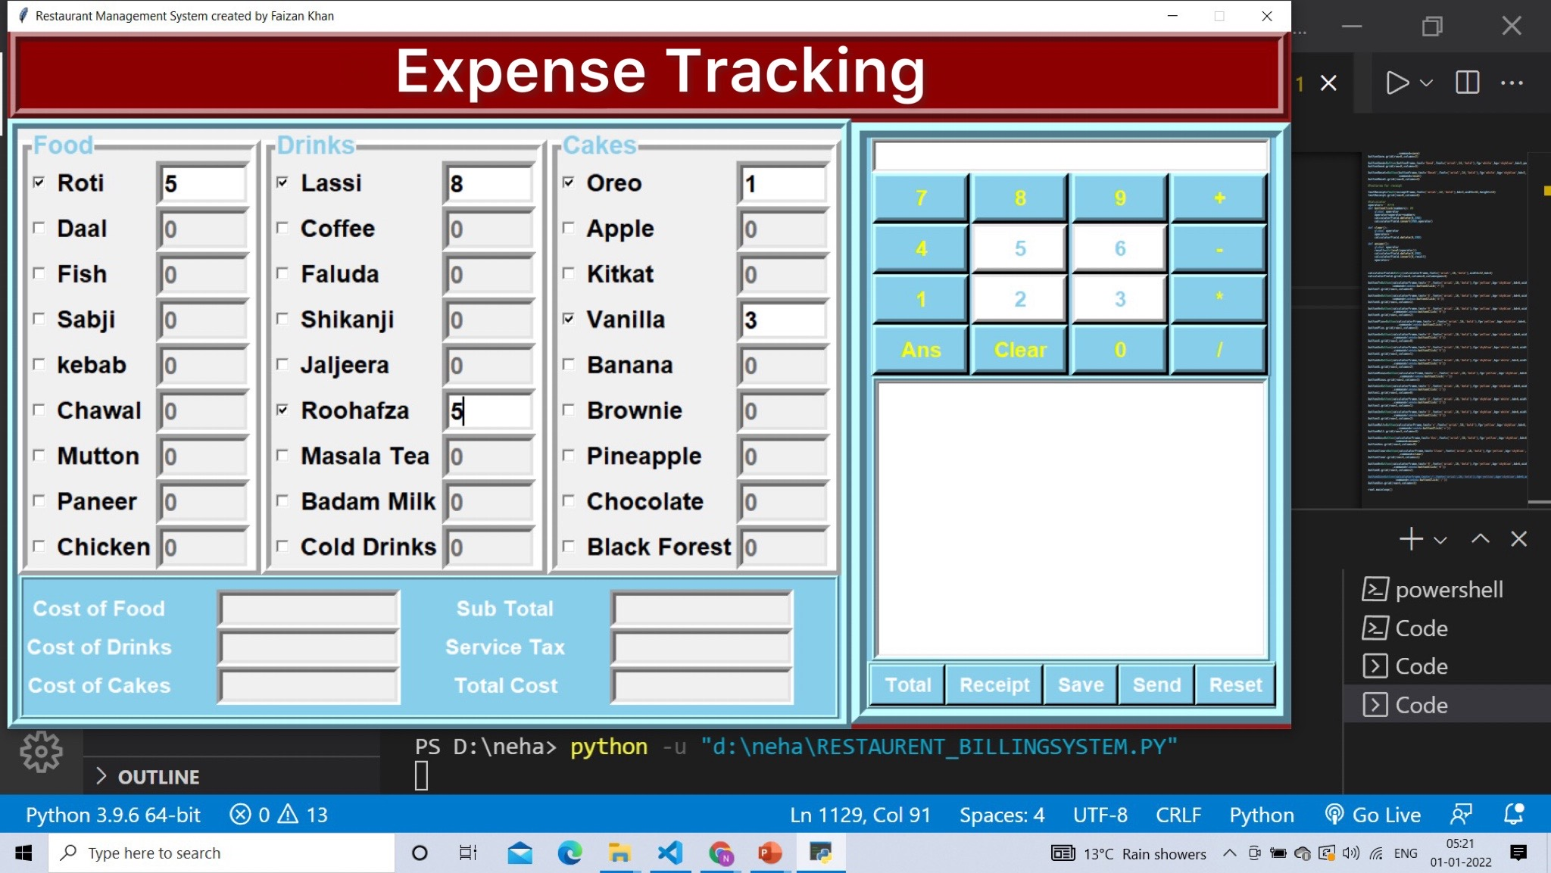
Screen shot when we entering the quantity:

Slide 8
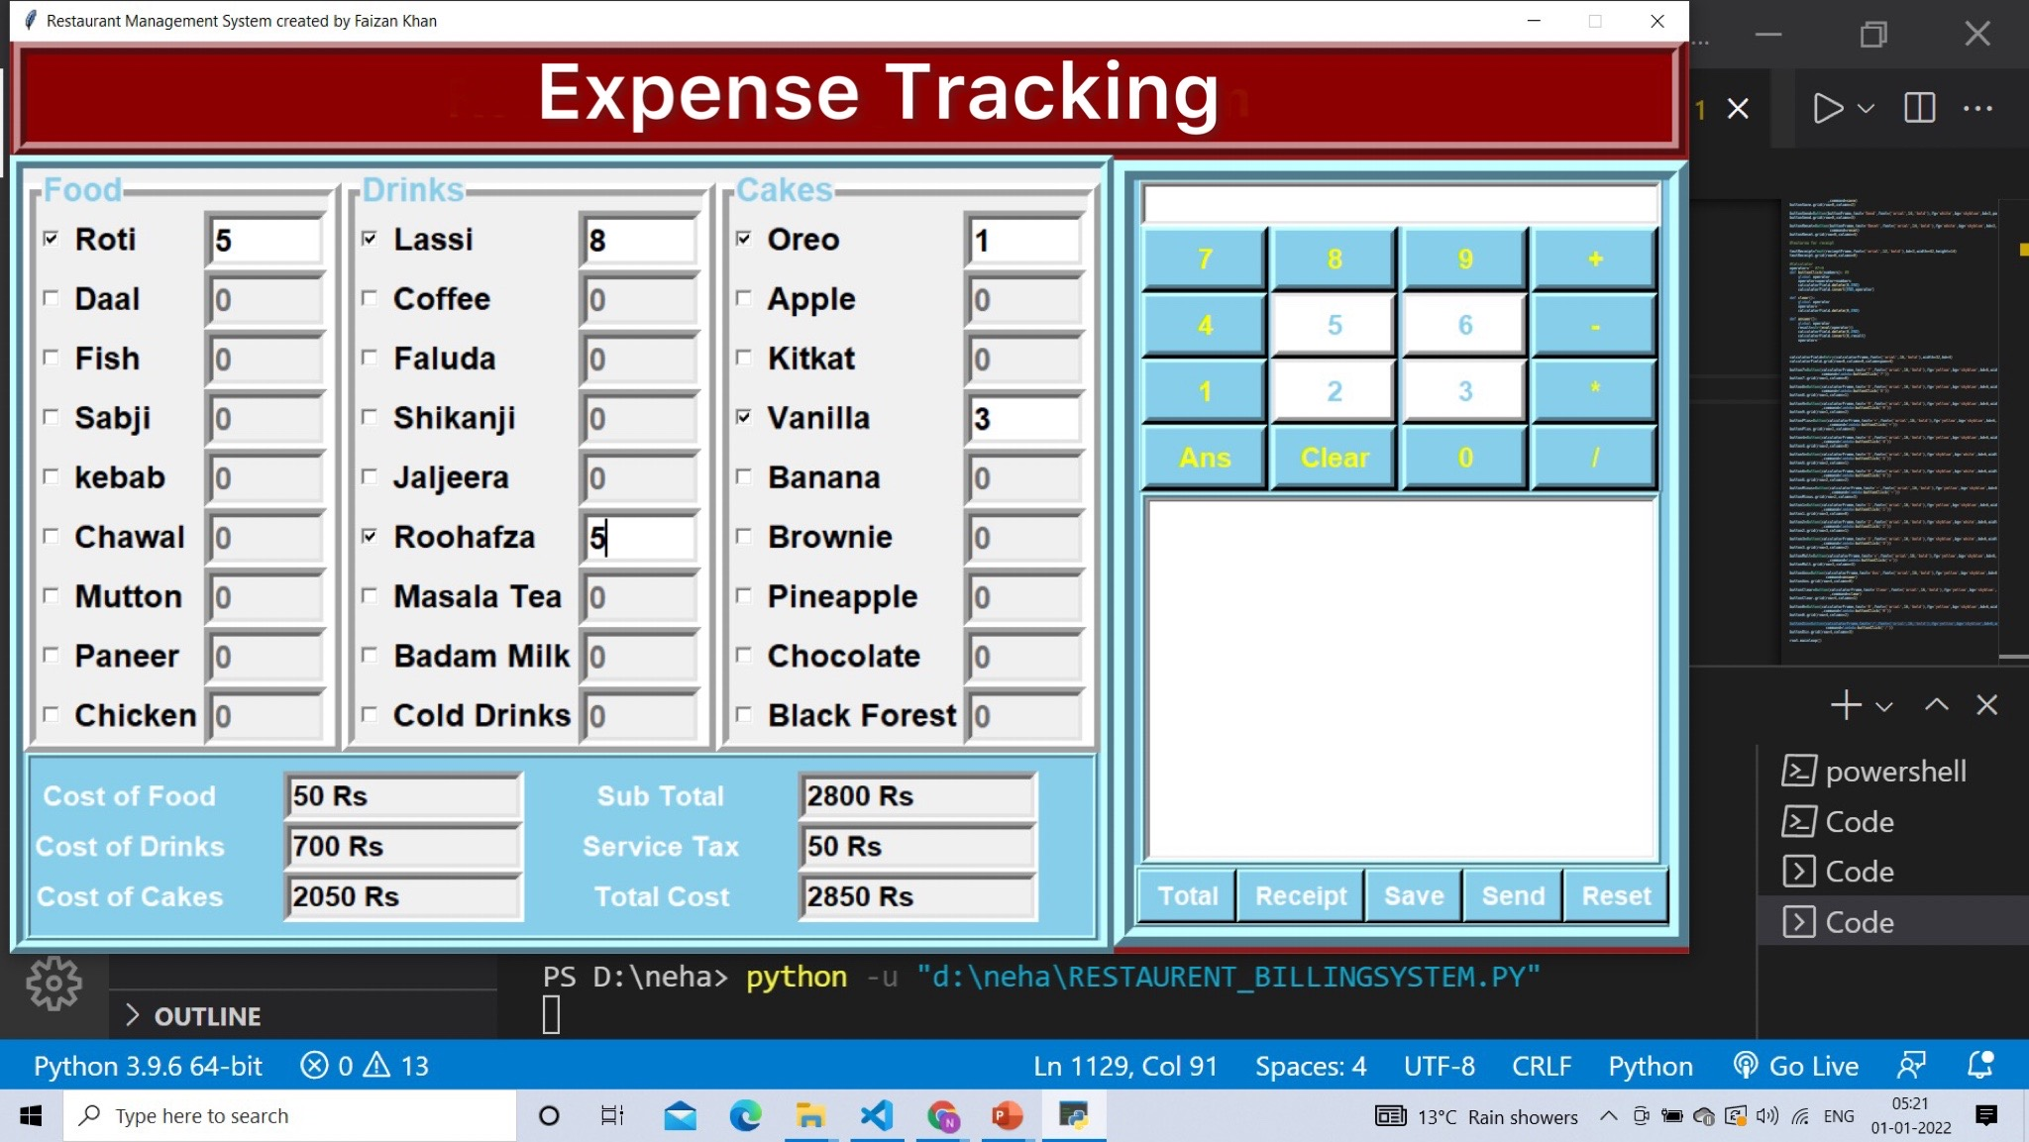
SCREENSHOT:WHEN WE PRESS THE TOTAL BUTTON

Slide 9
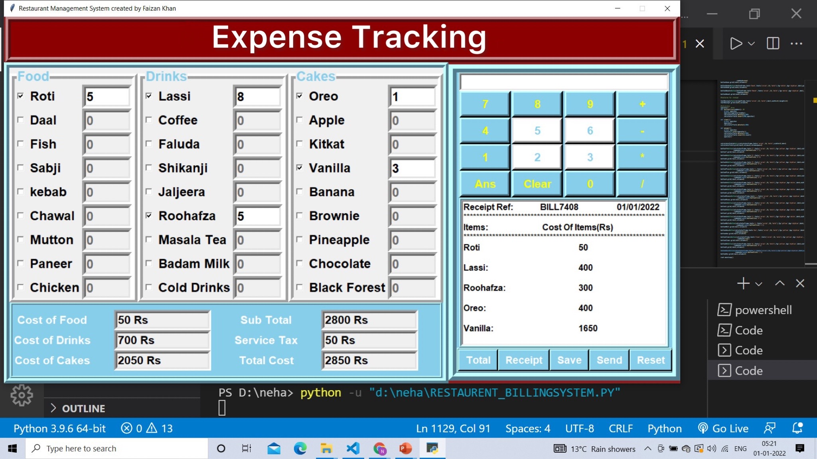
SCREEN SHOT WHEN WE CLICK THE RECIEPT BUTTON

Slide 10
FUTURE WORK
In future, this application can be updated with some more food items. Many other latest features can be added. Project will surely be enhanced with respect to looks and appearance and also as per user requirements. Many more functionalities can be added. Some enhancement can also be done with calculator. For now, this application generates the bill but with respect to future application it will be enhanced that it will also print a bill. It can also be used on a large scale. Many more modification can do with menu or prices or tax as well. It will be easy to use and bug free to all future or upcoming users. This can also be enhanced in future as per customer requirements. Many more features can be added. This will surely help users instead of making a bill manually.

Slide 11
CONCLUSION
The urge for the Expense Tracking System is increasing day by date. Expense Tracking System using Python is a perfect solution for this. Through this the ease of access and flexibility of the day to day works in the restaurant is made simpler. The features such as bill number, CGST and SGST make this software user friendly. Both the management side and worker site can manage the data easily using such a system. It is very good and reliable system which can be in corporate to the chain of hotels so can easily maintained and addressed .
It displays the service charges and the tax also. When the cashier clicks on the receipt button, the receipt is generated.

Slide 12
THANK YOU

